Slide 1
Clustering

Slide 2
Hierarchical Clustering
Two main types of hierarchical clustering
Agglomerative:
Start with the points as individual clusters
At each step, merge the closest pair of clusters until only one cluster (or k clusters) left
Divisive:
Start with one, all-inclusive cluster
At each step, split a cluster until each cluster contains a point (or there are k clusters)
Traditional hierarchical algorithms use a similarity or distance matrix
Merge or split one cluster at a time

Slide 3
Agglomerative Clustering Algorithm
More popular hierarchical clustering technique
Basic algorithm is straightforward
Compute the proximity matrix
Let each data point be a cluster
Repeat
Merge the two closest clusters
Update the proximity matrix
Until only a single cluster remains
Key operation is the computation of the proximity of two clusters
Different approaches to defining the distance between clusters distinguish the different algorithms

Slide 4
Starting Situation
Start with clusters of individual points and a proximity matrix
p1
p2
p3
p4
p5
. . .
p1
p2
p3
p4
p5
.
.
.
Proximity Matrix

Slide 5
Intermediate Situation
After some merging steps, we have some clusters
C1
C2
C3
C4
C5
C1
C2
C3
C3
C4
C4
C5
Proximity Matrix
C1
C2
C5

Slide 6
Intermediate Situation
We want to merge the two closest clusters (C2 and C5) and update the proximity matrix.
C1
C2
C3
C4
C5
C1
C2
C3
C3
C4
C4
C5
Proximity Matrix
C1
C2
C5

Slide 7
After Merging
The question is “How do we update the proximity matrix?”
C2 U C5
C1
C3
C4
C1
?
C2 U C5
? ? ? ?
C3
C3
?
C4
C4
?
Proximity Matrix
C1
C2 U C5

Slide 8
How to Define Inter-Cluster Similarity
p1
p2
p3
p4
p5
. . .
p1
Similarity?
p2
p3
p4
p5
MIN
MAX
Group Average
Distance Between Centroids
Other methods driven by an objective function
Ward’s Method uses squared error
.
.
.
Proximity Matrix

Slide 9
How to Define Inter-Cluster Similarity
p1
p2
p3
p4
p5
. . .
p1
p2
p3
p4
p5
MIN
MAX
Group Average
Distance Between Centroids
Other methods driven by an objective function
Ward’s Method uses squared error
.
.
.
Proximity Matrix

Slide 10
How to Define Inter-Cluster Similarity
p1
p2
p3
p4
p5
. . .
p1
p2
p3
p4
p5
MIN
MAX
Group Average
Distance Between Centroids
Other methods driven by an objective function
Ward’s Method uses squared error
.
.
.
Proximity Matrix

Slide 11
How to Define Inter-Cluster Similarity
p1
p2
p3
p4
p5
. . .
p1
p2
p3
p4
p5
MIN
MAX
Group Average
Distance Between Centroids
Other methods driven by an objective function
Ward’s Method uses squared error
.
.
.
Proximity Matrix

Slide 12
How to Define Inter-Cluster Similarity
p1
p2
p3
p4
p5
. . .
p1
×
×
p2
p3
p4
p5
MIN
MAX
Group Average
Distance Between Centroids
Other methods driven by an objective function
Ward’s Method uses squared error
.
.
.
Proximity Matrix

Slide 13
Hierarchical Clustering: Time and Space requirements
O(N²) space since it uses the proximity matrix.
N is the number of points.
O(N³) time in many cases
There are N steps and at each step the size, N², proximity matrix must be updated and searched
Complexity can be reduced to O(N² log(N) ) time for some approaches

Slide 16
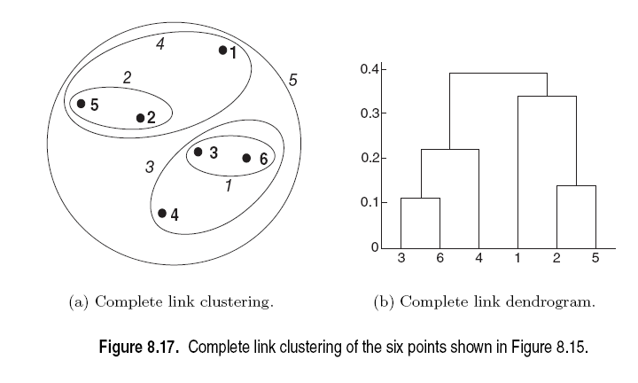

Slide 20
Single Linkage Clustering
It is an example of agglomerative hierarchical clustering.
We consider the distance between one cluster and another cluster to be equal to the shortest distance from any member of one cluster to any member of the other cluster.

Slide 21
Algorithm
Given a set of N items to be clustered, and an NxN distance (or similarity) matrix, the basic process of single linkage clustering is this:
1.Start by assigning each item to its own cluster, so that if we have N items, we now have N clusters, each containing just one item. Let the distances (similarities) between the clusters equal the distances (similarities) between the items they contain.
2.Find the closest (most similar) pair of clusters and merge them into a single cluster, so that now you have one less cluster.
3.Compute distances (similarities) between the new cluster and each of the old clusters.
4.Repeat steps 2 and 3 until all items are clustered into a single cluster of size N.

Slide 22
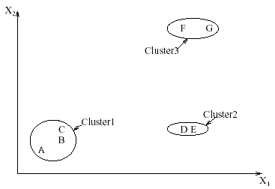
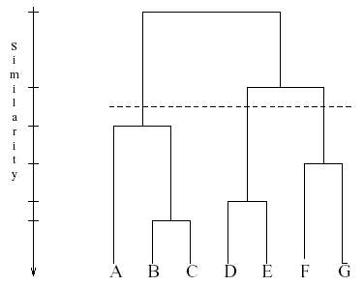
Interpreting Dendrograms
Clusters Dendrogram

Slide 23
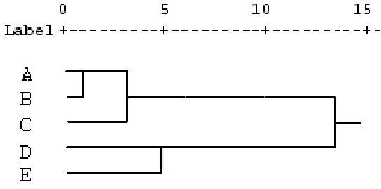
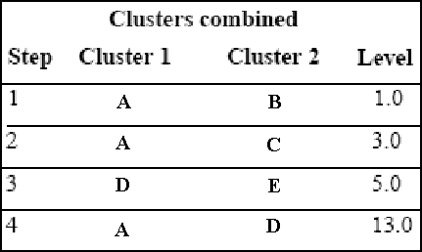
Agglomeration Schedule
 | A | B | C | D | E
A | 0
B | 1 | 0
C | 2 | 3 | 0
D | 8 | 9 | 10 | 0
E | 11 | 12 | 13 | 5 | 0

Slide 24
Advantages
Single linkage is best suited to detect lined structure
Invariant against monotonic transformation of the dissimilarities or similarities. For example, the results do not change, if the dissimilarities or similarities are squared, or if we take the log.
Intuitive

Slide 25

Problems
Do not scale well: time complexity of at least Ω(n²), where n is the number of total objects
It is not incremental. If new data is to be added, the whole analysis needs to be redone.
Can never undo what was done previously
Can lead to chaining
Data in the cluster must be compact.

Slide 26
How to Compute Group Similarity?
Three Popular Methods:
Given two groups g1 and g2,
Single-link algorithm: s(g1,g2)= similarity of the closest pair
Complete-link algorithm: s(g1,g2)= similarity of the farthest pair
Average-link algorithm: s(g1,g2)= average of similarity of all pairs

Slide 27
Three Methods Illustrated
complete-link algorithm
g1
g2
?
……
Single-link algorithm
average-link algorithm

Slide 28
Hierarchical: Single Link
cluster similarity = similarity of two most similar members
- Potentially long and skinny clusters
+ Fast
Notes:
I will start by motivating the work
next describe the Novel algorithm we developed
and then describe the experimental evaluation and present our results

Slide 29
Example: single link
5
4
3
2
1

Slide 30
Example: single link
5
4
3
2
1

Slide 31
Example: single link
5
4
3
2
2
1

Slide 32
Hierarchical: Complete Link
cluster similarity = similarity of two least similar members
+ tight clusters
+ Fast
Notes:
I will start by motivating the work
next describe the Novel algorithm we developed
and then describe the experimental evaluation and present our results

Slide 33
Example: complete link
5
4
3
2
2
1

Slide 34
Example: complete link
5
4
3
2
1

Slide 35
Example: complete link
5
4
3
2
1

Slide 36
Hierarchical: Average Link
cluster similarity = average similarity of all pairs
+ tight clusters
- slow
Notes:
I will start by motivating the work
next describe the Novel algorithm we developed
and then describe the experimental evaluation and present our results

Slide 37
Example: average link
5
4
3
2
1

Slide 38
Example: average link
5
4
3
2
1

Slide 39
Example: average link
5
4
3
2
1

Slide 40
Comparison of the Three Methods
Single-link
“Loose” clusters
Individual decision, sensitive to outliers
Complete-link
“Tight” clusters
Individual decision, sensitive to outliers
Average-link
“In between”
Group decision, insensitive to outliers
Which one is the best? Depends on what you need!

Slide 41
Hierarchical Clustering
Produces a set of nested clusters organized as a hierarchical tree
Can be visualized as a dendrogram
A tree like diagram that records the sequences of merges or splits

Slide 42
Strengths of Hierarchical Clustering
Do not have to assume any particular number of clusters
Any desired number of clusters can be obtained by ‘cutting’ the dendogram at the proper level
They may correspond to meaningful taxonomies
Example in biological sciences (e.g., animal kingdom, phylogeny reconstruction, …)

Slide 43
Cluster Similarity: MIN or Single Link
Similarity of two clusters is based on the two most similar (closest) points in the different clusters
Determined by one pair of points, i.e., by one link in the proximity graph.
1
2
3
4
5

Slide 44
Hierarchical Clustering: MIN
5
1
3
5
2
1
2
3
6
4
4
Nested Clusters
Dendrogram

Slide 45
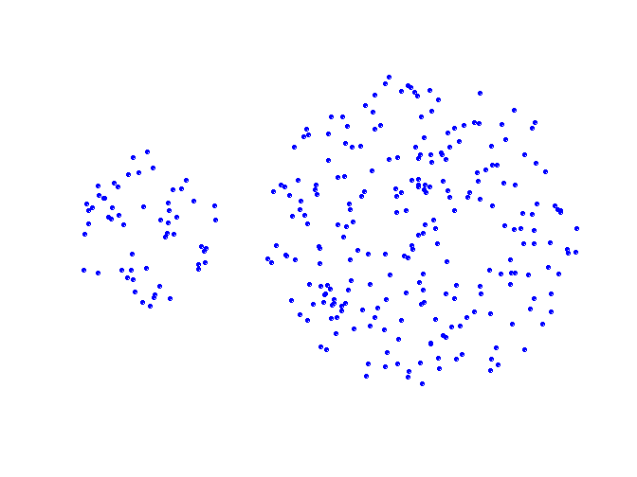
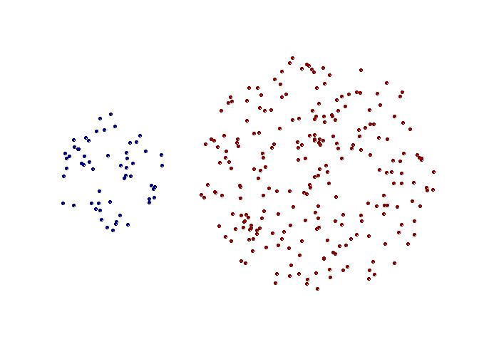
Strength of MIN
Original Points
Two Clusters
Can handle non-elliptical shapes

Slide 46
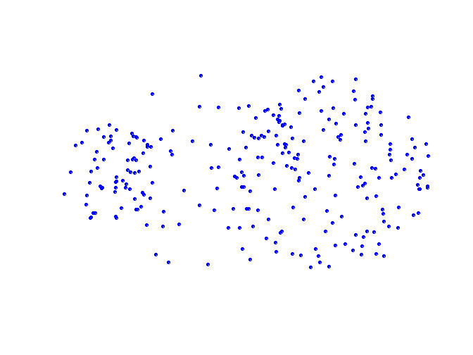
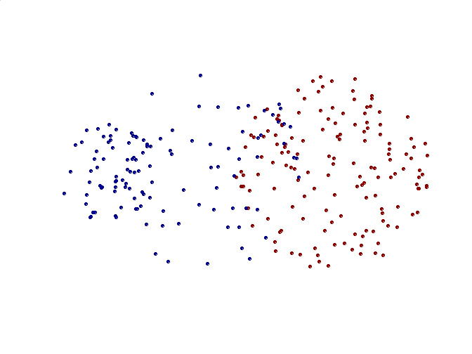
Limitations of MIN
Original Points
Two Clusters
Sensitive to noise and outliers

Slide 47
Cluster Similarity: MAX or Complete Linkage
Similarity of two clusters is based on the two least similar (most distant) points in the different clusters
Determined by all pairs of points in the two clusters
1
2
3
4
5

Slide 48
Hierarchical Clustering: MAX
4
1
2
5
5
2
3
6
3
1
4
Nested Clusters
Dendrogram

Slide 49
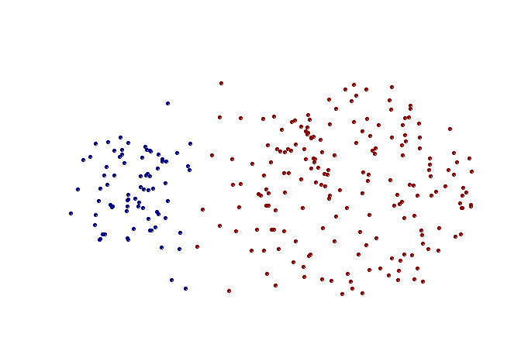
Strength of MAX
Original Points
Two Clusters
Less susceptible to noise and outliers

Slide 50
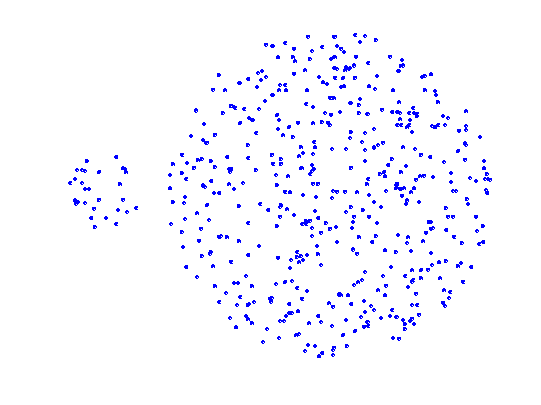
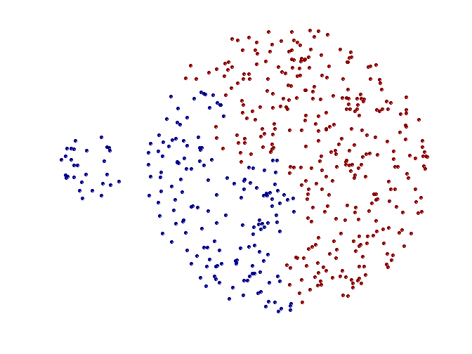
Limitations of MAX
Original Points
Two Clusters
Tends to break large clusters
Biased towards globular clusters

Slide 51
Cluster Similarity: Group Average
Proximity of two clusters is the average of pairwise proximity between points in the two clusters.
Need to use average connectivity for scalability since total proximity favors large clusters
1
2
3
4
5

Slide 52
Hierarchical Clustering: Group Average
5
4
1
2
5
2
3
6
1
4
3
Nested Clusters
Dendrogram

Slide 53
Hierarchical Clustering: Group Average
Compromise between Single and Complete Link
Strengths
Less susceptible to noise and outliers
Limitations
Biased towards globular clusters

Slide 54
Cluster Similarity: Ward’s Method
Similarity of two clusters is based on the increase in squared error when two clusters are merged
Similar to group average if distance between points is distance squared
Less susceptible to noise and outliers
Biased towards globular clusters
Hierarchical analogue of K-means
Can be used to initialize K-means

Slide 55
Hierarchical Clustering: Comparison
5
1
4
1
3
2
5
5
5
2
1
MIN
2
MAX
2
3
6
3
3
6
1
4
4
4
5
4
1
5
2
1
5
Ward’s Method
2
2
5
3
2
6
Group Average
1
3
6
4
3
1
3
4
4

Slide 56
Hierarchical Clustering: Problems and Limitations
Once a decision is made to combine two clusters, it cannot be undone
No objective function is directly minimized
Different schemes have problems with one or more of the following:
Sensitivity to noise and outliers
Difficulty handling different sized clusters and convex shapes
Breaking large clusters

Slide 57
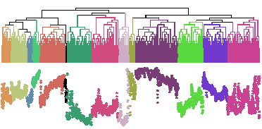
Problems with Dendrogram
Messy to construct if number of points is large.
Number of observations = 6113

Slide 58
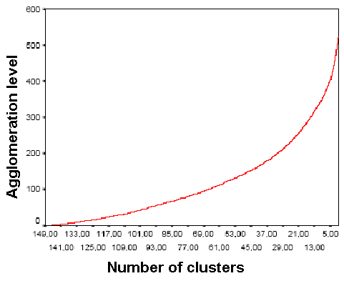
Deciding where to cut the Dendrogram can be difficult
As shown, if there are no sharp elbow knicks in the Inverse Scree Test, then it is difficult to find the number of clusters from the dendrogram
Inverse Scree test

Slide 59
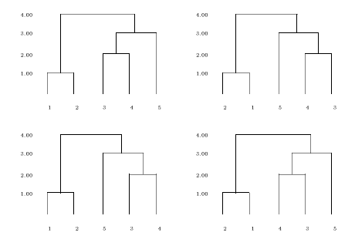

Comparing two Dendrograms is not straightforward
The four dendrograms all represent the same data. They can be obtained from each other by rotating a few branches.
H_{n} denotes the number of simply equivalent dendrograms for n objects.

